Slide 1



Introduction to Environmental Impact Assessment (EIA)
Environmental Impact Assessment (EIA) is a comprehensive process used to evaluate the potential environmental consequences of a proposed project or activity. It aims to identify, predict, and mitigate the various impacts on the environment, ensuring sustainable development.
by Manoj Oguri

Slide 2
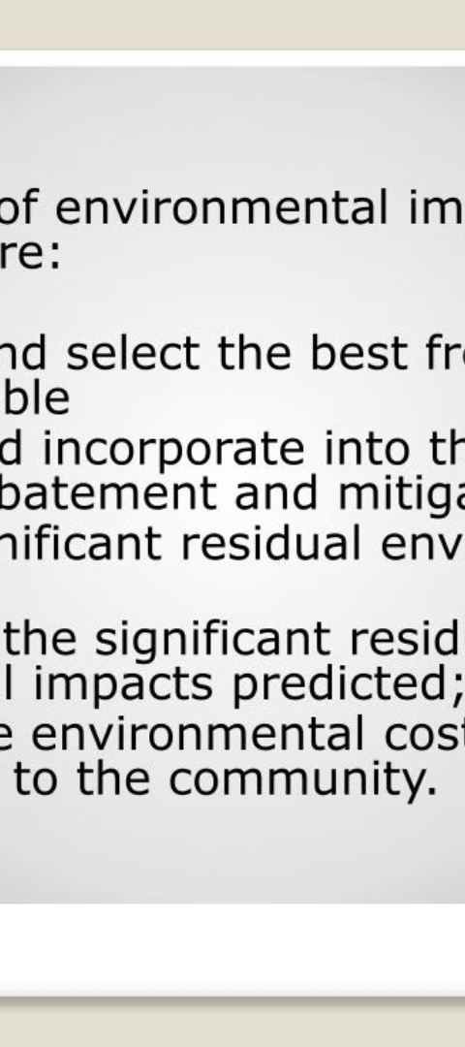
Purpose and Objectives of EIA
1
Identify Potential Impacts
2
Evaluate Significance
EIA helps identify the potential positive and negative environmental, social, and economic impacts of a proposed project or activity.
The assessment process evaluates the significance of the identified impacts, considering factors such as magnitude, duration, and reversibility.
3
Propose Mitigation
EIA provides recommendations for mitigation measures to minimize or prevent the adverse impacts and enhance the positive impacts.

Slide 3
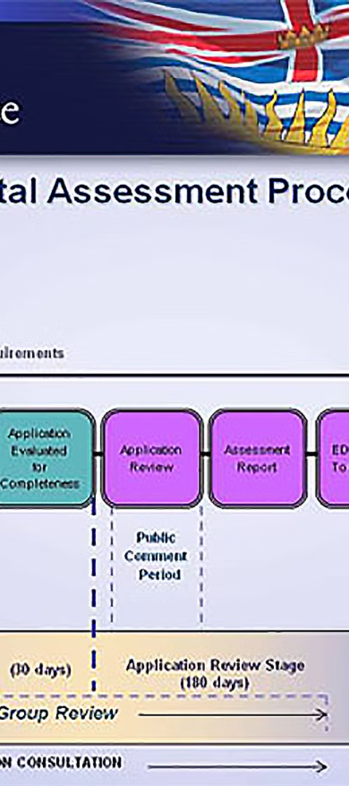
Stages of the EIA Process
1
Screening
Determining if an EIA is required based on the project's characteristics and potential environmental significance.
2
Scoping
Defining the focus, depth, and extent of the EIA, identifying key issues and potential impacts to be addressed.
3
Impact Assessment
Conducting detailed studies to analyze the potential environmental, social, and economic impacts of the proposed project.

Slide 4

Baseline Environmental Studies
Biophysical
Socioeconomic
Collecting data on the existing physical, chemical, and biological characteristics of the environment, such as air quality, water resources, and wildlife habitats.
Gathering information on the human population, land use, economic activities, and cultural resources in the project area.
Environmental Sensitivity
Identifying environmentally sensitive areas, protected ecosystems, and vulnerable communities that may be impacted by the proposed project.

Slide 5
Identification and Evaluation of Impacts
Direct Impacts
Indirect Impacts
Cumulative Impacts
Immediate effects caused by the project, such as habitat destruction, pollution, or displacement of local communities.
Secondary effects that may occur as a result of the project, like changes in land use, economic opportunities, or social dynamics.
The combined effects of the project with other existing or planned activities in the region, which can amplify environmental stress.

Slide 6




Mitigation Measures and Monitoring Plans
Avoidance
Minimization
Compensation
Monitoring
Modifying the project design to prevent or minimize adverse impacts before they occur.
Implementing measures to reduce the duration, intensity, or extent of unavoidable impacts.
Providing replacements or offsets for impacts that cannot be avoided or minimized.
Ongoing assessment of the project's environmental performance and the effectiveness of mitigation measures.

Slide 7



Stakeholder Engagement and Public Participation
Community
Government
Environmental Advocates
Engage local communities to understand their concerns, knowledge, and perspectives on the project's potential impacts.
Collaborate with regulatory agencies to ensure compliance with environmental laws and regulations.
Involve environmental organizations and experts to provide technical input and promote sustainable practices.

Slide 8

Conclusion and Recommendations
1
Informed Decision-making
2
Sustainable Development
3
Continuous Improvement
EIA provides decision-makers with a comprehensive understanding of a project's potential impacts, enabling informed and responsible choices.
By identifying and addressing environmental risks, EIA promotes the integration of environmental considerations into project planning and implementation.
The EIA process and its outcomes should be regularly reviewed and updated to incorporate new knowledge and best practices.

